Slide 1
Non-Invasive point of care ECG signal detection and analytics for cardiac diseases
Bachelor Thesis project
Presented by
Shubham Kumar Gupta (180107058)
Mentors
Prof. Dipankar Bandyopadhyay
Prof. Resmi Suresh
Sahil Jagnani

Slide 2
Content
Basic Analysis
What’s ECG? ¹
How ECG Signal Look Like? ¹²
Why is it important to measure ECG? ¹
Depth Analysis
Structure & Functioning of Heart ²
Visualizing Electric Pulses in Heart ²
Stages of ECG ²
ECG Cycles ²
How ECG is done? ²
Fluctuations in ECG ²
Different Cardiac Disease ECG Analysis ²
Market and Device Analysis
Devices that can measure ECG ¹
Limitations: Devices that can measure ECG ¹
Modern Devices that can measure ECG ¹
Working of Mawi Band ¹
DIY available? ¹
Publications & Library ¹
Statistics & Market Analysis ¹
Tools Analysis
Bio-Sensors ^{2 ?}
ML/DL & Sample Dataset Explore²
DIY ²
Ideation (not sure this will work) ²
What’s for me then? ¹
Timeline ¹²
bit.ly/btp2Aug
Prev ppt: bit.ly/btp21Aug

Slide 3
Content
Summary
Case Study
Apple’s ECG Watch
Kardia 6L
Sanket’s 12Lead
OMsignal smartwear(Out Of Scope)
Constraints
Hardware Analysis
Heart Beat Sensor Working
Oximeter Sensor (BPM & SpO₂ Level)
Sensor MAX30100
Grove Finger-Clip Heart Rate Sensor
NeuroSky CardioChip
BMD101 (No information provided)
Hardware Setup
Working Principle
Block Diagram
Circuit Diagram
Ideation
Data Collection
Types of data collected
Resources
Timeline
Thank You

Slide 4
DISCLAIMER
I have no intention to harm any products related to Apple or any company!
No userbase is targeted or tried to offended using this!
I am studying them just for research and educational purposes.

Slide 5
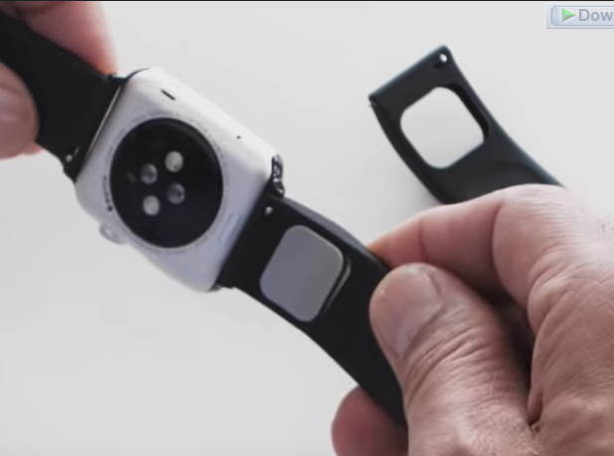
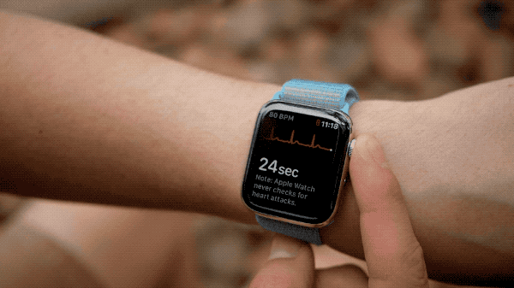
Case Study: Apple’s ECG Watch/Kardia Band
Bought & Transformed : AliveCor Band (Kardia is a product of AliveCor)
ECG any time (30 seconds wait time)
Results on ECG app
Types of ECG (SINGLE LEAD CANNOT DETECT ANYTHING ELSE?)
Sinus rhythm (uniform 50-100 BPM) ¹
Atrial fibrillation (APPLE needed 2 versions to do this !)
Version 1: can track AF till 50-120 BPM¹
Version 2: can track AF till 50-150 BPM²
Low or high heart rate
Version 1: can track HB <50 or >120 BPM¹
Version 2: can track HB <50 or >150 BPM²
Inconclusive
Heart Rate is from 100-120 BPM but not Atrial Fibrillation¹
Recording cannot be classified ¹
Wearing Pacemaker? ¹
Poor Recording¹

Slide 6
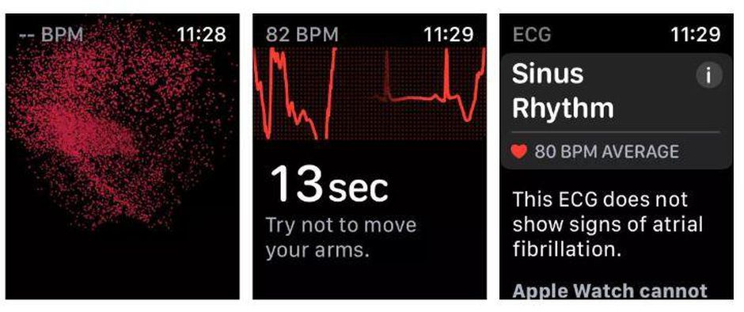
Case Study: Apple’s ECG Watch
Rest your arms on a table or in your lap while you take a recording. Try to relax and not move too much.
Make sure that your Apple Watch isn’t loose on your wrist. The band should be snug, and the back of your Apple Watch needs to be touching your wrist.
Clean & Dry
Move away from any electronics that are plugged into an outlet to avoid electrical interference.
Liquid-free contact is required for the ECG app to work properly
THINGS TO CONSIDER!!
The ECG app cannot detect a heart attack. If you ever experience chest pain, pressure, tightness, or what you think is a heart attack, call emergency services immediately.
The ECG app cannot detect blood clots or a stroke.
The ECG app cannot detect other heart-related conditions. These include high blood pressure, congestive heart failure, high cholesterol, or other forms of arrhythmia.

Slide 7
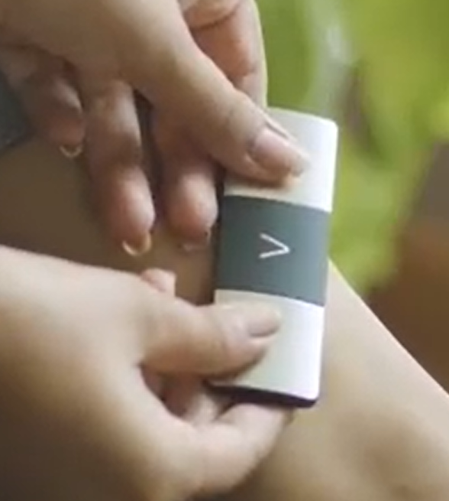
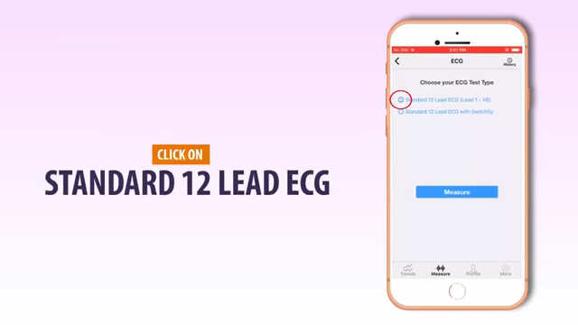
Case Study: Apple’s ECG Watch
Workings
Generates a single-lead (or Lead I) ECG.
A single-lead ECG is able to provide information about heart rate and heart rhythm and enables classification of AFib.
single-lead ECG cannot be used to identify conditions like heart attacks.
ECG app to accurately classify an ECG recording into AFib (98.3% accuracy) and sinus rhythm (99.6% accuracy).
Kardia Workings
It has two electrodes on the top for your fingers, and one on the bottom to contact the skin of your left leg.
So one have to touch it with two thumbs and touch the bottom via left leg
It generates 6Leads
It delivers EKG leads I, II, III, aVL, aVR, and aVF.
Sanket’s 12 Lead ECG
Can generates 12lead Ecg
Complicated & may not be possible easily to do ECG (anywhere)
Slight misplacement can cause errors

Slide 8
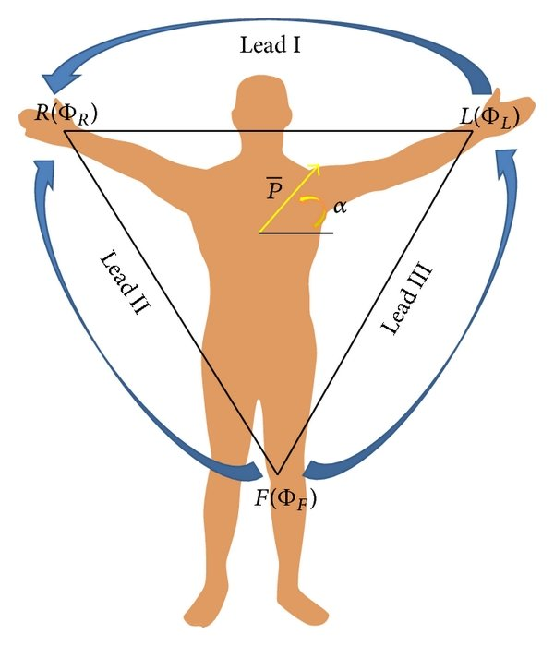
Constraints
From Two thumbs you can get Lead I
From Two thumbs + Left Leg we can get II,III and aVF,aVR,aVL
From Touching points at Chest we can get rest Leads
TARGET
WATCH (ECG + Heart-Beat)
CHEST LEADS ❌
LEADS I ✔️
LEADS II, III (May be if touched leg) 💡 (If then can have aVL, aVF, aVR)
Different Leads shows
II, III, and aVF: inferior surface of the heart
V1 to V4: anterior surface
I, aVL, V5, and V6: lateral surface
V1 and aVR: right atrium and cavity of left ventricle
Without touching different body parts (like leg/chest) we cannot have any leads other than Lead I
Continuous ECG cannot be done as one have to keep circuit completed everytime so one need to touch both hands

Slide 9
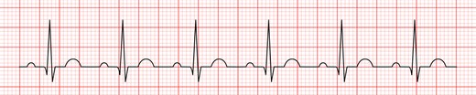
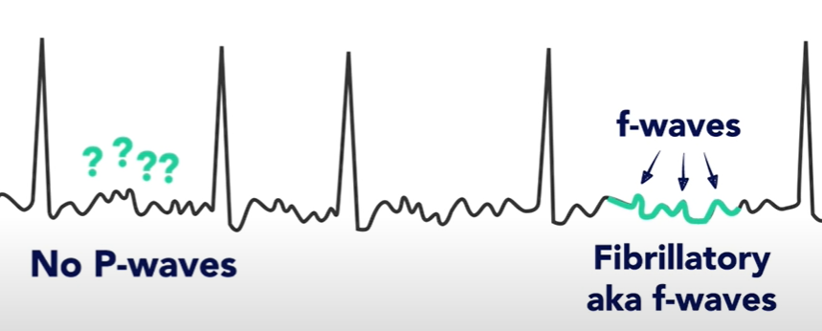
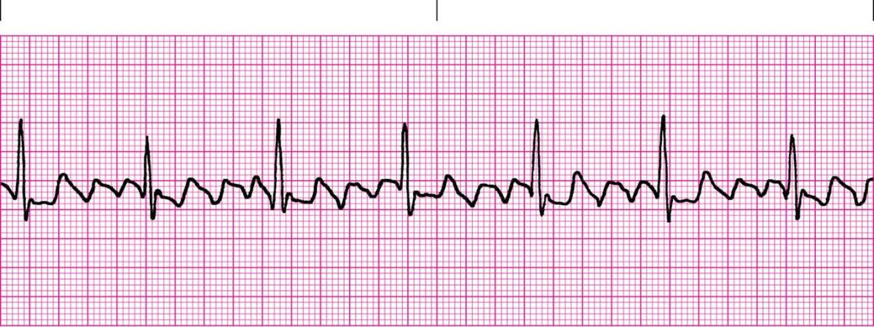
Constraints
TARGET
Get leads I, interpret, then go for leads II, III, then we can have aVF, aVL & aVR
Normal Sinus Rhythm ✔️
The P wave is upright in leads I and II
Each P wave is usually followed by a QRS complex
The heart rate is 60-99 BPM
Atrial Fibrillation ✔️
Lead I, Narrow QRS Complex, Irregular RR interval
f (fibrillatory) waves
No distinct P waves
Atrial Flutter ✔️
Lead I, Narrow QRS Complex, Regular RR interval
f (fibrillatory) waves
No distinct P waves
Low/High Heart Rates ✔️
From ECG RR intervals heart rate can be calculated
Normal Sinus Rhythm
Atrial Fibrillation
Atrial Flutter

Slide 10
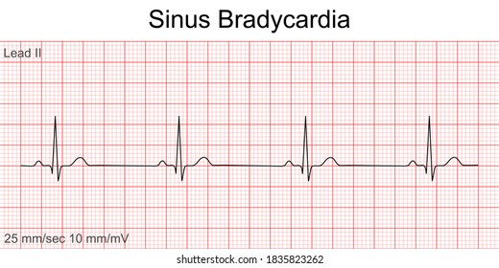
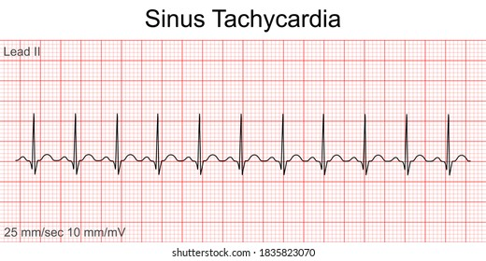
Constraints
Sinus Bradycardia ✔️
Rate < 60 BPM
Regular intervals
P wave present normal
PR interval & QRS width normal
Sinus Tachycardia ✔️
Rate > 100 BPM
Regular intervals
P wave present normal
PR interval & QRS width normal
Cardiac Axis (💡 MAYBE)
Normal Axis Deviation
Lead II has most +ve deflection compared to leads I and III.
Left Axis Deviation ( -30° to -90°)
Lead I has most +ve deflection.
Leads II and III are –ve .
Right Axis Deviation
Lead III has most +ve deflection and lead I should be –ve.
Sinus Bradycardia
Sinus Tachycardia
Leads | Normal Axis | Right Axis Deviation | Left Axis Deviation
Lead I | +ve | -ve | +ve
Lead II | +ve | +ve/-ve | -ve
Lead III | +ve/-ve | +ve | -ve

Slide 11
Working Principle
Φ is potentials at different regions
Lead I: 𝑉_{I} = Φ_{L −} Φ_{R}
Lead II: 𝑉_{II} = Φ_{𝐹 −} Φ_{R}
Lead III: 𝑉_{III} = Φ_{𝐹 −} Φ_{𝐿}
On completing the circuit by touching Left and Right thumbs or arms we can get Lead I.
𝑎𝑉F = Φ_{𝐹} − (Φ_{𝐿} + Φ_{𝑅})/2
𝑎𝑉L = Φ_{L} − (Φ_{F} + Φ_{𝑅})/2
𝑎𝑉R = Φ_{R} − (Φ_{F} + Φ_{L})/2
Cardiac Axis = ± tan⁻¹ (𝑎𝑉𝐹/V_{I} )
When circuit completes by touching any two points then we can get potential difference between any two points defining it to give Lead I, II, III, etc

Slide 12
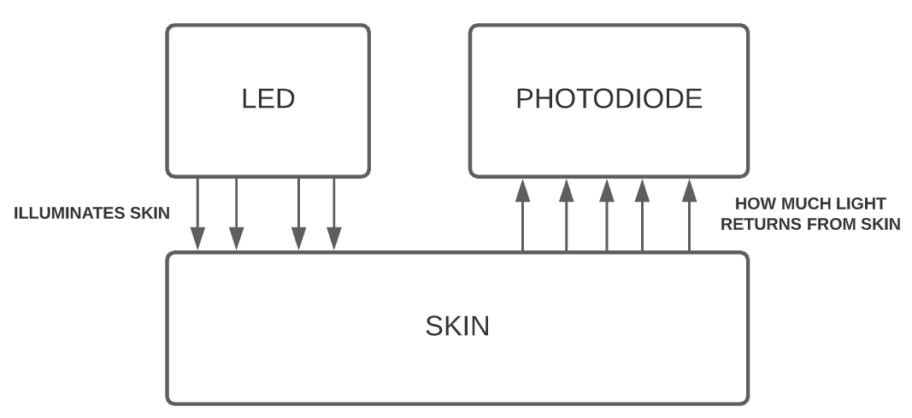
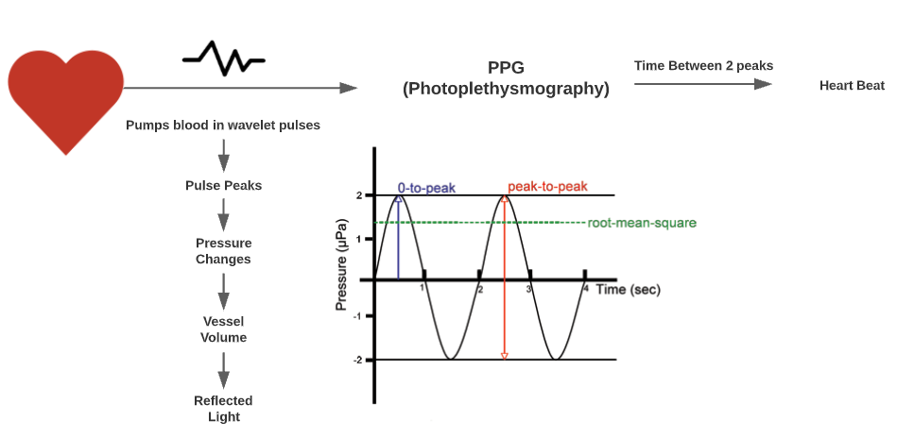
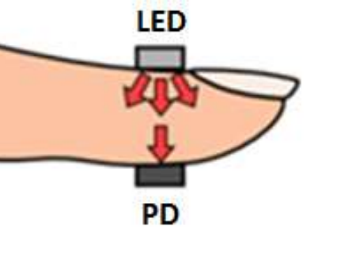
Heart Beat Sensor Working
A basic heart sensor works on the principle of photoplethysmography.
Plethysmography is a measurement technique that can be used to measure the volume changes in different parts of the body.
A plethysmograph is an instrument for measuring changes in volume within an organ or whole body
Two modes :
Transmissive mode - fingers / toes / earlobe
Reflective - forehead / cheek
The shorter wavelengths of light are strongly absorbed by melanin, Red and near-IR light passes easily.
Eg: Oximeter Sensor

Slide 13
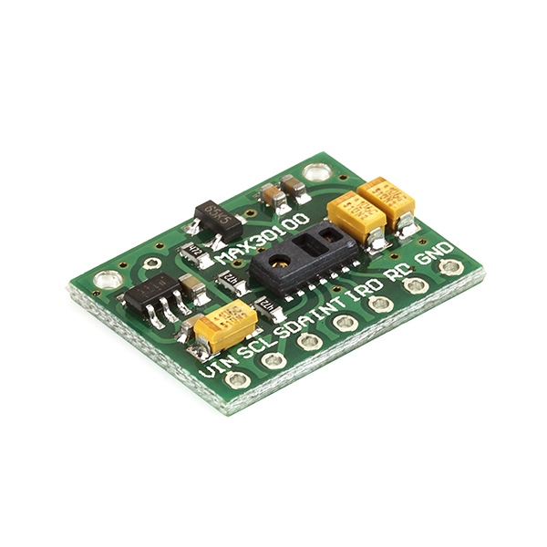
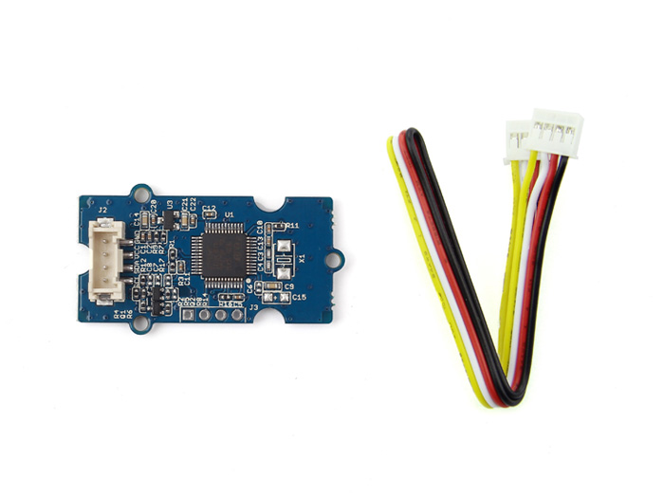
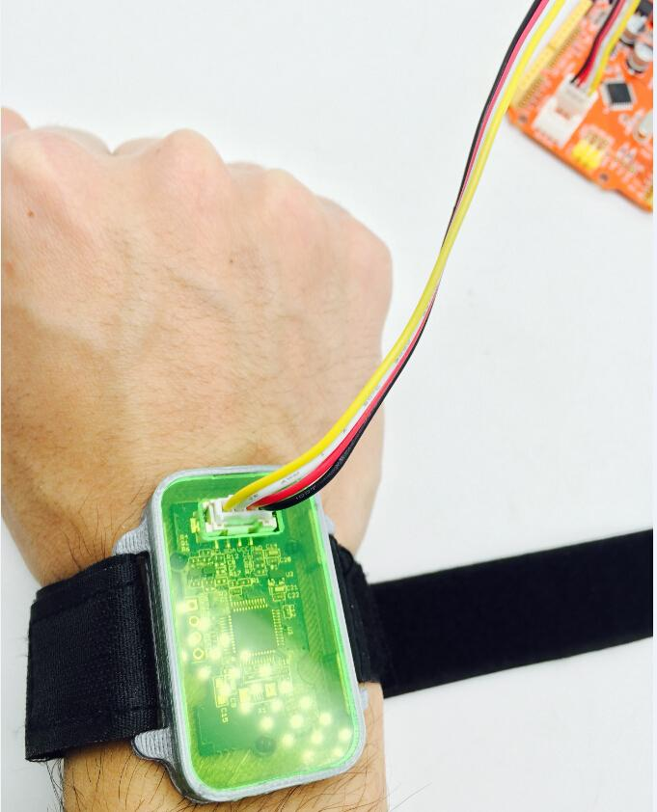
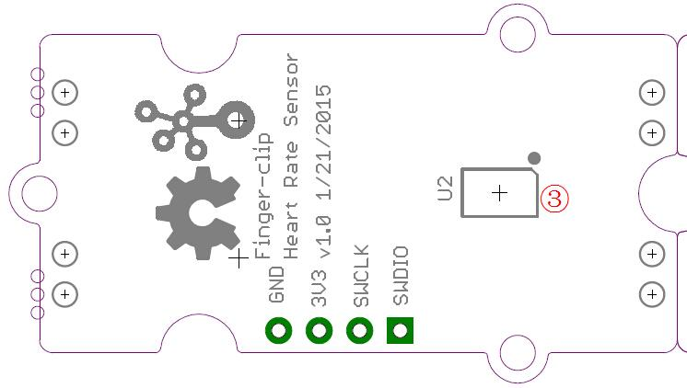
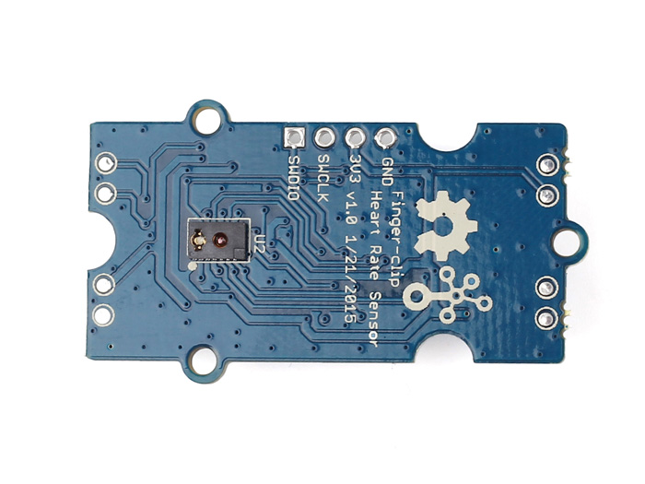
Oximeter Sensor
Sensor MAX30100
It’s an integrated pulse oximetry and heart-rate monitor sensor solution.
It works on the principle of photoplethysmography.
It combines two LEDs, a photodetector, optimized optics, and low-noise analog signal processing to detect pulse oximetry and heart-rate signals.
But we shouldn’t use this as the sensor height is lower than other components of the circuit.
Grove Finger-Clip Heart Rate Sensor
Base has the sensor same as Oximeter sensor and no other components on its base
So can be used easily assuming no size constraints initially
NeuroSky CardioChip
They only share data with large commercials
Very small
No data publicly available

Slide 14
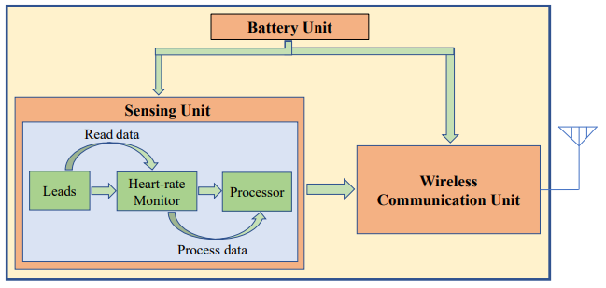
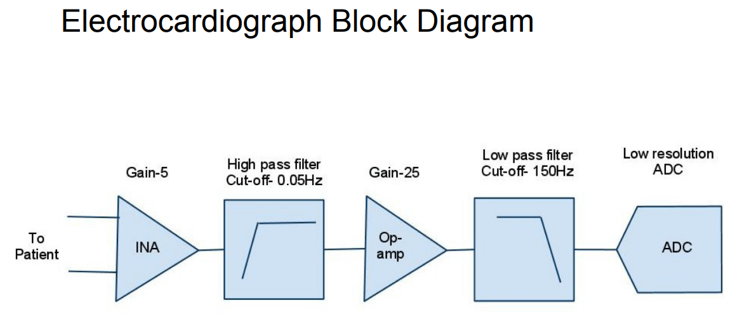
Block Diagram
Figure shows the block diagram that can be implemented on a circuit box as watch.
It should contain total of three units:
Battery Unit (Power Source)
Sensing Unit
Wireless Communication Unit
Sensing Unit
should capture leads
Monitor heart rate
Process them like passing wave via various electrical circuits like amplifier or band pass filters, and denoising the final output signal
Then Analog signals are converted to digital signals and sent to Wireless Unit
Wireless Communication Unit
Output data generated from sensing unit should be transferred to mobile application using the wireless may be wifi/Bluetooth/internet cloud channels

Slide 15
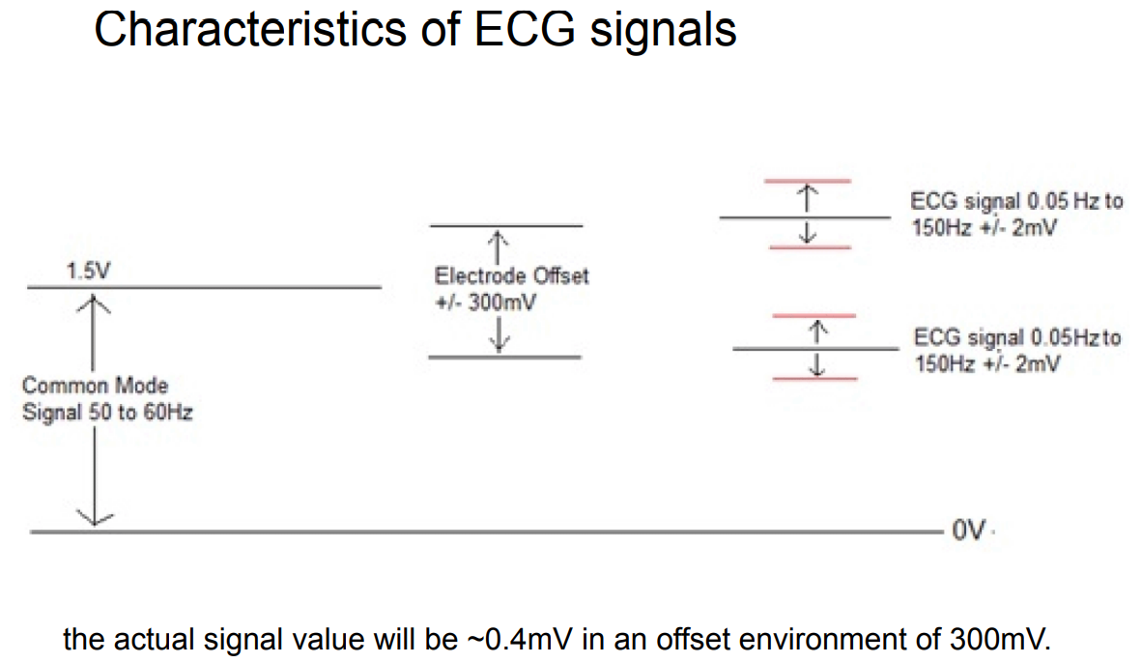
Block Diagram
Output Analog Voltage ECG signals may vary from person to person.
The front end of an ECG must be able to deal with extremely weak signals ranging from 0.5 mV to 5.0 mV
DC component of up to ±300 mV, resulting from the electrode-skin contact
And a common-mode component of up to 1.5 V, resulting from the potential between the electrodes and ground.
Useful bandwidth of an ECG signal depends on the application
range from 0.5 Hz to 50 Hz—for a monitoring application in intensive care units
Uto 1 kHz for late-potential measurements (pacemaker detection).
A standard clinical ECG application has a bandwidth of 0.05 Hz to 100 Hz.

Slide 16
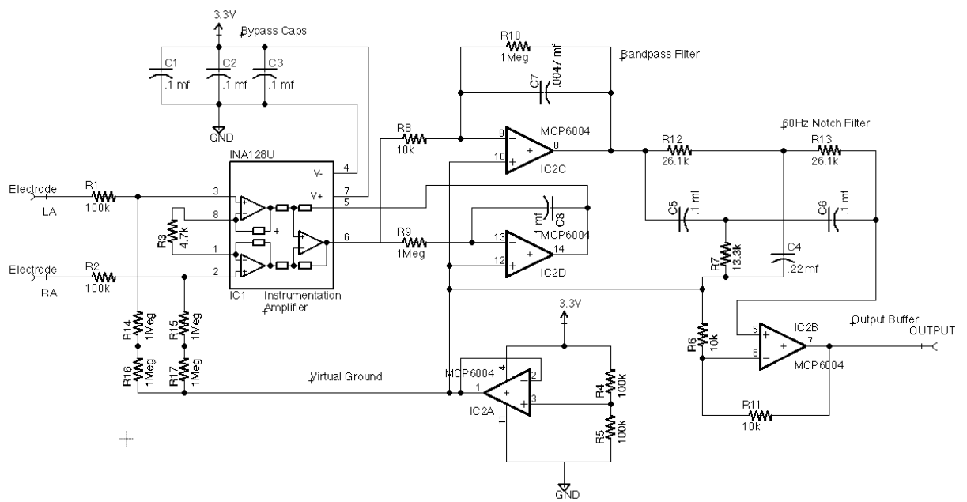
Circuit Diagram

Slide 17
Circuit Diagram

Slide 18
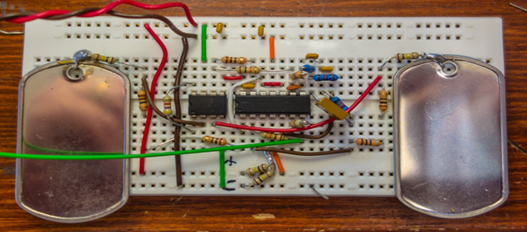
Circuit Diagram

Slide 19

Circuit Diagram
3.3v
R2
GND
R9
R1
R8
R10
8 7 6 5
14 13 12 11 10 9 8
ELECTRODE 2
R15
INA128U
MCP6004
R14
ELECTRODE 1
R3
1 2 3 4 5 6 7
1 2 3 4
R11
R17
R6
R16
R4
R5

Slide 20
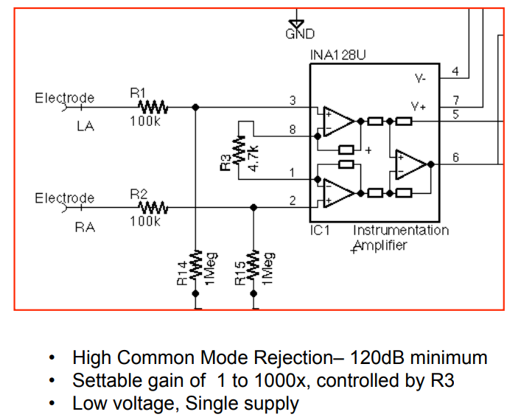
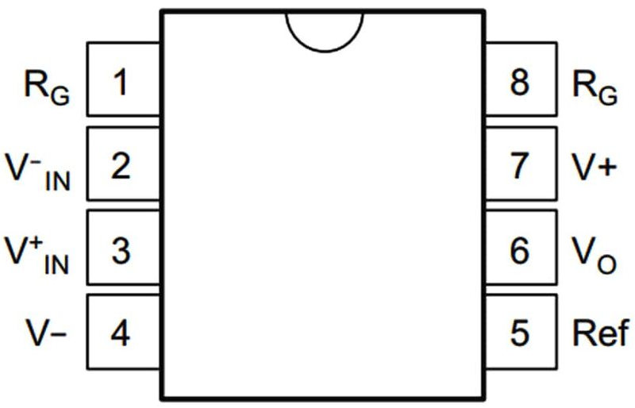
Circuit Diagram
Instrumentation Amplifier
Amplifier is a circuit that has a power gain greater than one.
It can either be a separate piece of equipment or an electrical circuit contained within another device.
Amplification is fundamental to modern electronics, and amplifiers are widely used in almost all electronic equipment.
INA128U
Made by Texas Instruments
It’s a low-power, general purpose instrumentation amplifiers offering excellent accuracy. The versatile 3-op amp (8pins) design and small.

Slide 21
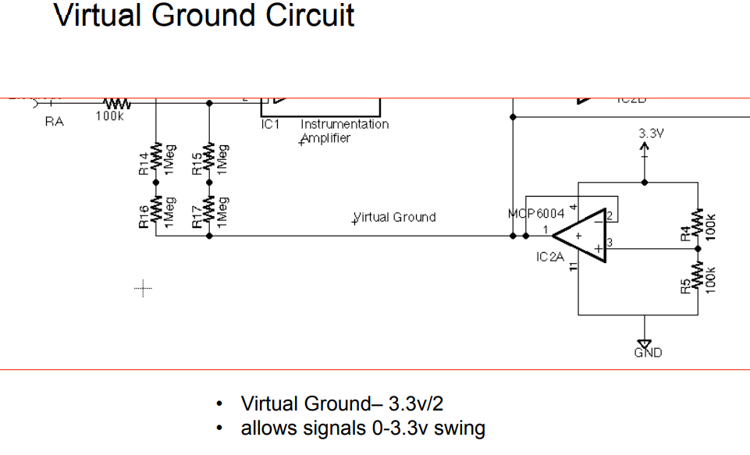
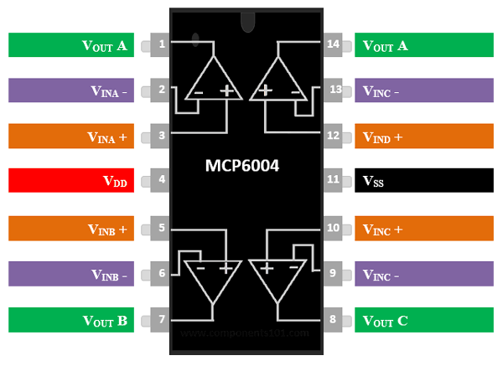
Circuit Diagram
Ground Circuit
3.3V as power source
Ground as 0 V
Op-Amp
Operational amplifier is DC-coupled high-gain electronic voltage amplifier with a differential input and, usually, a single-ended output.
Op-amps are known for their low power and high bandwidth gain.
Op amps are used widely in electronic devices today, including a vast array of consumer, industrial, and scientific devices.
MCP6004
It’s a Quad Op-amp (14-Pin) package.
It’s a quad general purpose op amp offering rail-to-rail input and output over the 1.8 to 6V operating range.
This amplifier has a typical gain–bandwidth product (GBWP) of 1 MHz with current only 100 microamperes.
The MCP6004 is available in 14-lead PDIP, SOIC and TSSOP packages

Slide 22
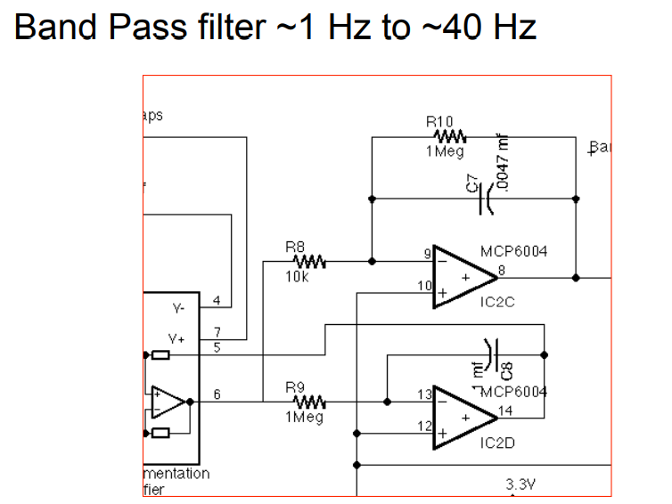
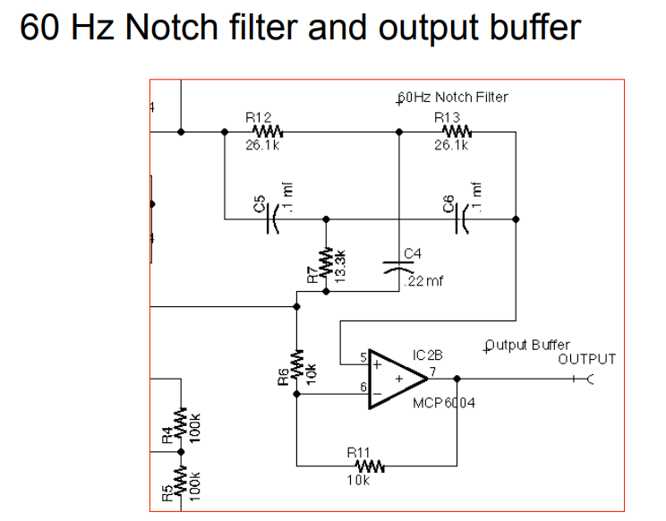
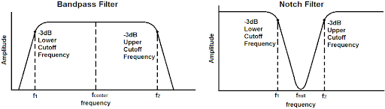
Circuit Diagram
Band-pass filter
It’s a device that passes frequencies within a certain range and rejects (attenuates) frequencies outside that range
Here range used is 1Hz to 40Hz signals are passed
Notch filter
It’s a type of band-stop filter, which is a filter that attenuates frequencies within a specific range while passing all other frequencies unaltered.
Range of frequencies is very narrow.
Range of frequencies that a band-stop filter attenuates is called the stopband.

Slide 23
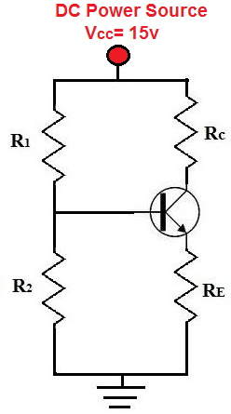
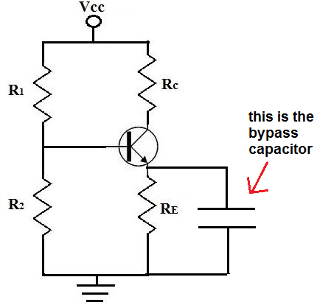
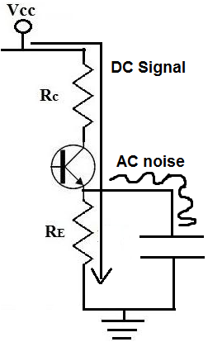
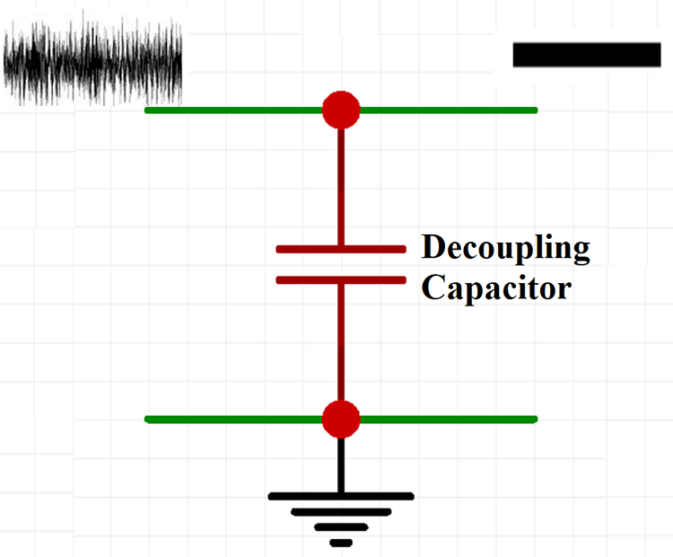
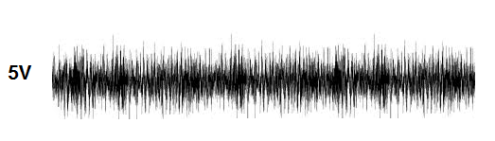
Circuit Diagram
Bypass capacitor
It shorts AC signals to ground, so that any AC noise that may be present on a DC signal is removed, producing cleaner DC signal.
The value of the bypass capacitor should be at least 1/10th of the resistance across the emitter resistance, RE at the lowest frequency intended to be bypassed.

Slide 24
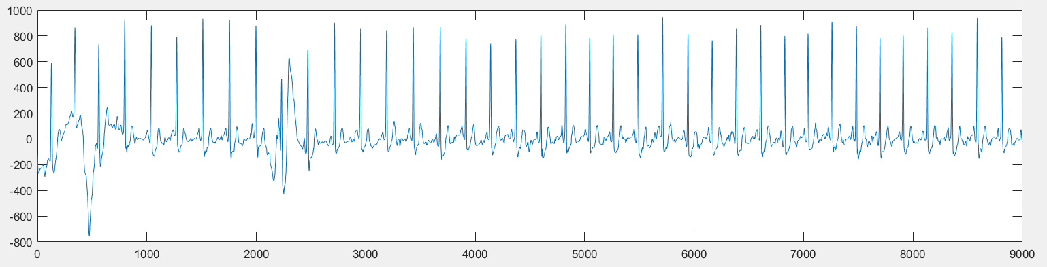
Datacollection
Reference taken from
AF Classification from a short single lead ECG recording: the PhysioNet/Computing in Cardiology Challenge 2017
Needed Variety
Different Age
Different Time
Different Workouts
Different Temperature
Types of data that can be collected:
Technical Data
Amplitude(in mV) v/s time plot
Heart Rate
Actual Afib, tachycardia, etc data
Age
Gender
Food Habits
Any disease
Mental stress
Plotted a Sample data taken from physionet cardiology data

Slide 25
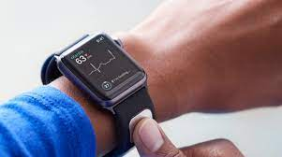
Ideation
Stage 1
Can assemble a basic circuit system
Data collection and Tweaking
Stage 2
Convert two electrodes into single electrode one pressed over skin
Styling it as watch
Stage 3
Data Collection
Stage 4
Develop a mobile application (preferably Blynk)
Stage 5
Develop ML model

Slide 26
Resources
Accessing the ECG Data of the Apple Watch and Accomplishing Interoperability Through FHIR (researchgate.net)
Taking an ECG with the ECG app on Apple Watch Series 4, Series 5, or Series 6 - Apple Support (IN)
CSE 466 Lab 7: Analog Front End for an Electrocardiograph (washington.edu)
CSE466 lectures (washington.edu)
True Unipolar ECG Machine for Wilson Central Terminal Measurements (researchgate.net)
A Novel Wearable Device for Continuous Ambulatory ECG Recording: Proof of Concept and Assessment of Signal Quality (nih.gov)
Electronics | Free Full-Text | Advances of ECG Sensors from Hardware, Software and Format Interoperability Perspectives (mdpi.com)
Comparison of Baseline Wander Removal Techniques considering the Preservation of ST Changes in the Ischemic ECG: A Simulation Study (hindawi.com)
Passive Detection of Atrial Fibrillation Using a Commercially Available Smartwatch | Atrial Fibrillation | JAMA Cardiology | JAMA Network
Comparison of Baseline Wander Removal Techniques considering the Preservation of ST Changes in the Ischemic ECG: A Simulation Study (hindawi.com)

Slide 27
Timeline
Points taken under consideration to create timeline
Total of 4months for BTP
15 days interval so 8 reviewal meets
Resolution
Hardware sensors
ML parameters
Datasets
Results Till (Tn) 2nd AUG 2021
Basic Analysis
Results After 15 days (Tn+15) 21st AUG 2021
Research paper review for ECG smartwatches
Devices Available
Publications
Market Statistics
Deep Analysis
Study of Sensors
Results After 30 days (Tn+30) 8^{th Sept 2021}
Hardware Analysis
Gather ECG datasheets available
Expected Results After 45 days (Tn+450) 24^{th Sept 2021}
Hardware Setup
How to collect data?
Data Collection
Mobile Application Setup
Final Ideation

Slide 28
Thank You!

Slide 29
Liquid used in ECG Slight changes in ECG Actually How & Why we are getting this graph? Verification FDI approval? Theranos Technical objection? Sensor?
POINTS TO CORRECT 2nd AUG
POINTS TO CORRECT 21ST AUG
2 pages

